Slide 1

Solution 4: Message GUI

Slide 2
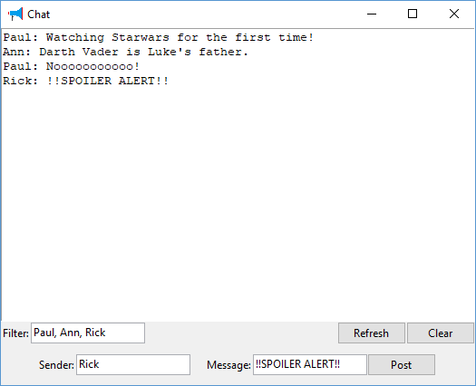
Solution 4: Message GUI
Message Board
Notes:
Not too ruff
Won’t hurt my felines.
Getters and Setters (not the Irish kind)
No need to Pause between them

Slide 3
import tkinter
from tkinter import ttk
import corkboard
board = corkboard.CorkBoard()
corkboard.make_example_data(board)
def post_message():
print("POST MESSAGE")
mes = corkboard.Message(text_sender.get(),text_message.get(),"TODO NOW")
board.post_message(mes)
refresh()
def refresh():
senders = text_from.get().split(',')
messages.configure(state="normal")
messages.delete('1.0', tkinter.END)
for ms in board.get_messages_from(senders):
messages.insert(tkinter.END,str(ms)+"\n")
messages.configure(state="disabled")
def clear():
board.clear()
refresh()

Slide 4
top = tkinter.Tk()
messages = tkinter.Text(top, height=10, width=70)
messages.pack(fill=tkinter.BOTH,expand=1)
row1 = tkinter.Frame(top)
lab_show = ttk.Label(row1,text="Show from",width=10,anchor=tkinter.E)
lab_show.pack(side=tkinter.LEFT)
text_from = ttk.Entry(row1)
text_from.pack(side=tkinter.LEFT,fill=tkinter.X,expand=1)
bt_clear = ttk.Button(row1,text="Clear",command=clear)
bt_clear.pack(side=tkinter.RIGHT)
bt_refresh = ttk.Button(row1,text="Refresh",command=refresh)
bt_refresh.pack(side=tkinter.RIGHT)
row1.pack(fill=tkinter.X)
row2 = tkinter.Frame(top)
lab_sender = ttk.Label(row2,text="Sender",width=10,anchor=tkinter.E)
lab_sender.pack(side=tkinter.LEFT)

Slide 5
text_sender = ttk.Entry(row2)
text_sender.pack(side=tkinter.LEFT)
lab_message = ttk.Label(row2,text="Message")
lab_message.pack(side=tkinter.LEFT)
text_message = ttk.Entry(row2)
text_message.pack(side=tkinter.LEFT,fill=tkinter.X,expand=1)
bt_post = ttk.Button(row2,text="Post",command=post_message)
bt_post.pack(side=tkinter.LEFT)
row2.pack(fill=tkinter.X)
refresh()
top.mainloop()

